Slide 1
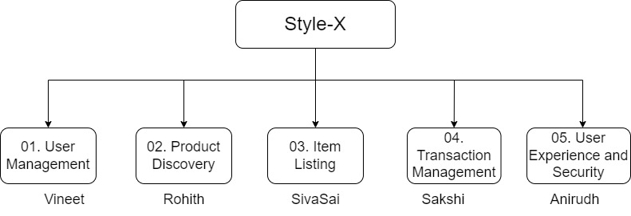
TEAM 1 – GROUP 1 & 2 PROJECT : StyleX Functional Decomposition Diagram

Slide 2
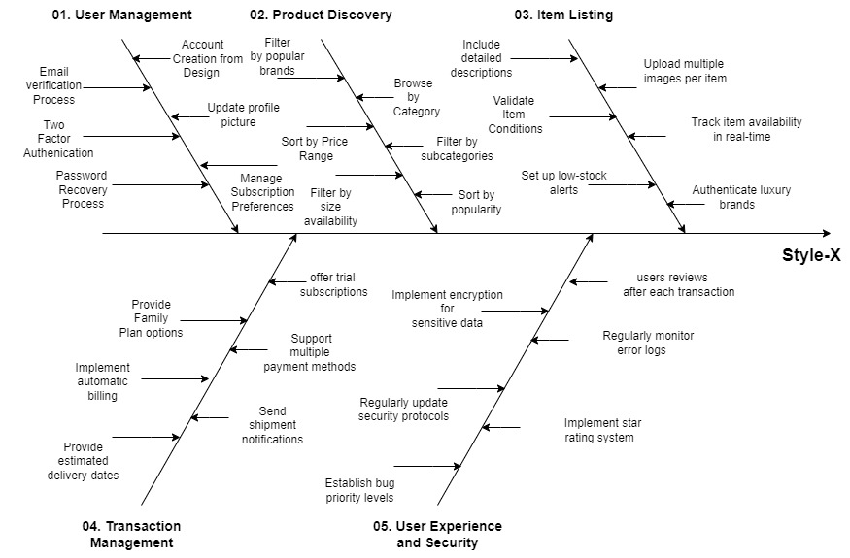
StyleX: Fishbone Diagram

